Slide 1



Comparing taxonomic resolution of 16s and metagenomic pipelines
Ryleigh Griffin and Rishi Soni

Slide 2
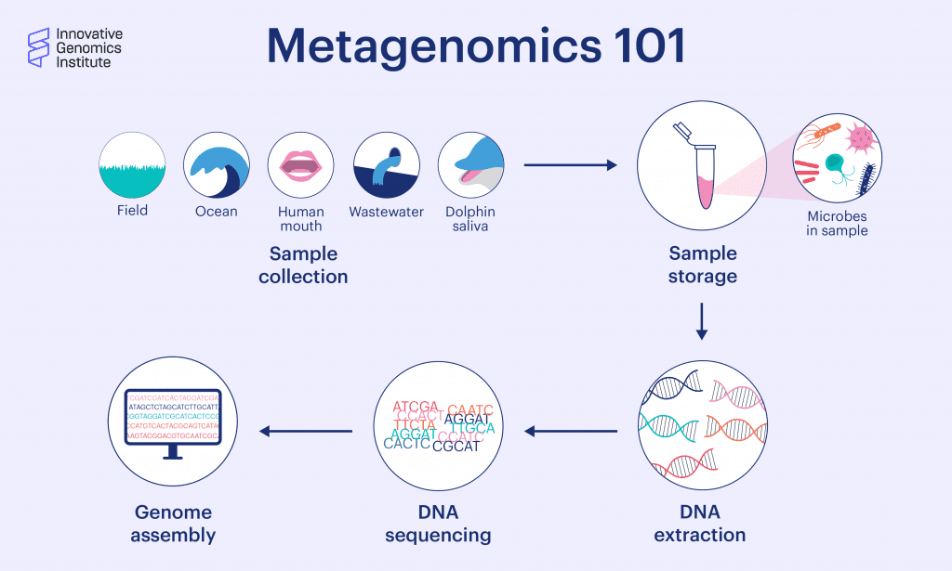
Notes:
Microbial communities
Collected from a variety fo environments
Dna extracted for sequencing

Slide 3
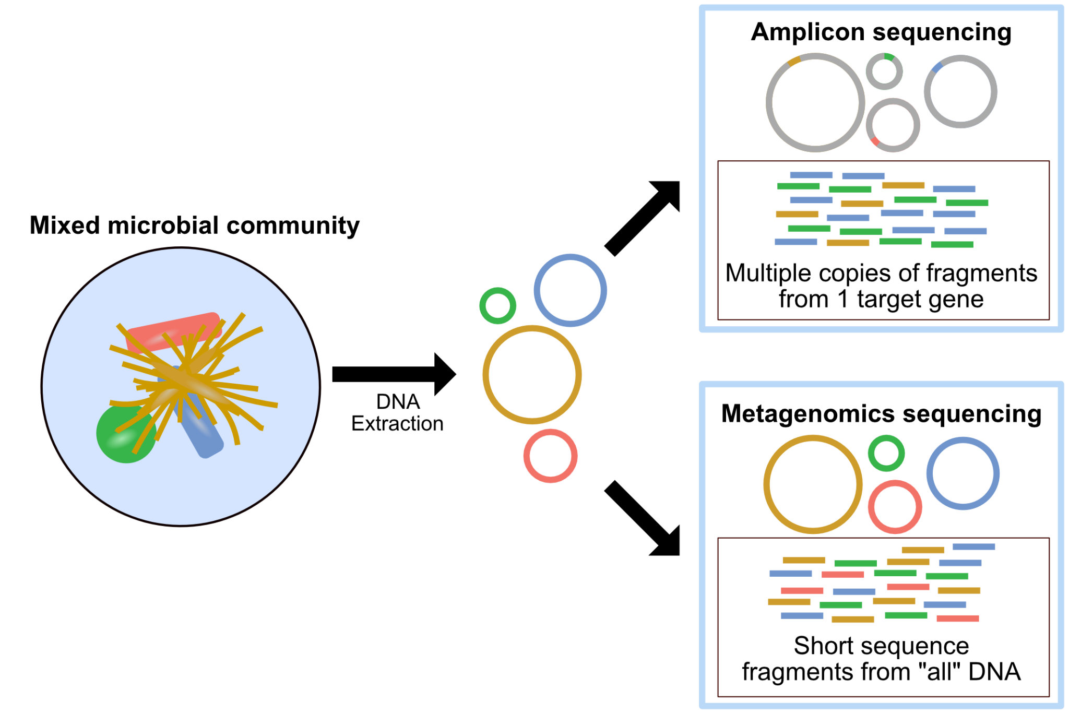
Notes:
https://astrobiomike.github.io/misc/amplicon_and_metagen
Why would we do one vs the other?

Slide 4
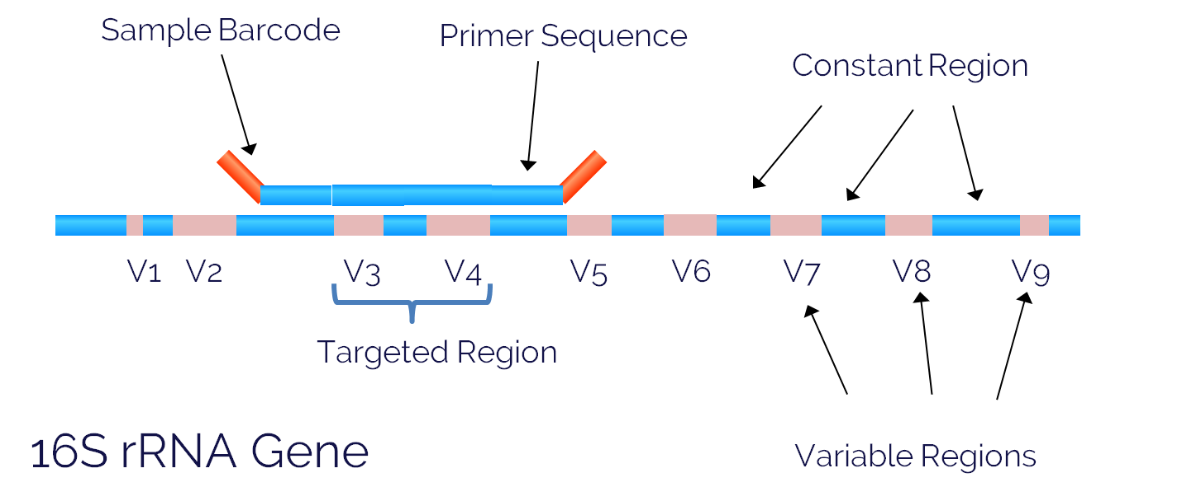
16S Sequencing
Notes:
https://lcsciences.com/services/dna-sequencing/16s-rrna-gene-sequencing/microbiome-analysis/

Slide 5
How do 16s and metagenomic sequencing compare?
Notes:
How do these two different sequencing techniques compare? Looking specifically their resolution, the data we’re able to pull out, etc etc
With applications to the field of metagenomics (why we would do one versus the other, things to keep in mind as you’re choosing a research technique)

Slide 6
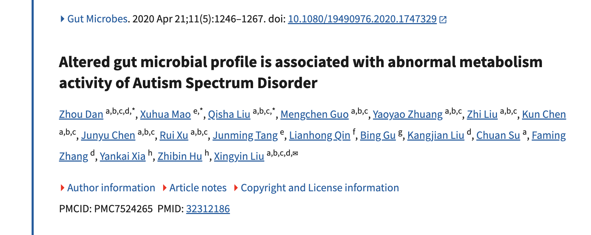
Dataset contains both 16s and metagenomic data
Notes:
GI issue common correlated with Autism Spectrum Disorder
The author’s research question here was, is autism spectrum disorder correlated with changes in the gut microbiome of children?
They took fecal samples from children with and without autism spectrum disorder
16s data on all 143 subjects (range of ages from 3 to 13)
For a subset (60, 30 with and without) who had constipation issues, they also did metagenomic sequencing and analysis on the fecal samples
They found that there was a small difference in the microbiome between the two groups, with some of the variable groups of bacteria associated with
Metabolism (they posit some interaction between the gut microbiome, metabolism, and neurotransmitters)
We had two goals: can we recreate their figures? Can we compare our 16s analysis to our metagenomic analysis?
Also make sure to note that our metagenomic pipeline only worked on 10 out of 60 samples

Slide 7
16s Pipeline - Paper
FLASH
Merge reads
QIIME
Estimate richness index
UChime/UParse/RDP classifier
Additional processing

Slide 8
16s Pipeline - Paper
FLASH
Merge reads
QIIME
Estimate richness index
UChime/UParse/RDP classifier
Additional processing

Slide 9
16S Pipeline - Our Reproduction
DADA2
Reads to ASV
PhyloSeq
Organizes Data
Notes:
Ampliconequence variants

Slide 10
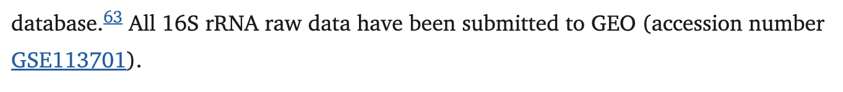
16S Pipeline - Our Reproduction
DADA2
Reads to ASV
PhyloSeq
Organizes Data
Notes:
figure

Slide 11
Metagenomic Pipeline - Paper
SOAPdenovo
Assemble reads
CD-HIT
Remove redundant genes
DIAMOND
Align against reference

Slide 12
Metagenomic Pipeline - Paper
Not meant for metagenomics?
SOAPdenovo
Assemble reads
CD-HIT
Remove redundant genes
DIAMOND
Align against reference

Slide 13
Metagenomic Pipeline - Our reproduction
Kraken2
Classifies reads
Bracken
Estimates abundance
kraken-biom
Ready for analysis
Due to computing power limitations, only a subset (10 out of 60) of the dataset was processed this way
Notes:
Note: this is not assembly-based
Initially wanted to use megahit, but the galaxy browser did not have any of the tools available for getting phylogenetic data
And as you’ll see, it was representative but we did also use the output table uploaded by the authors

Slide 14
Can we reproduce published figures?
Notes:
How do these two different sequencing techniques compare? Looking specifically their resolution, the data we’re able to pull out, etc etc
With applications to the field of metagenomics (why we would do one versus the other, things to keep in mind as you’re choosing a research technique)

Slide 15
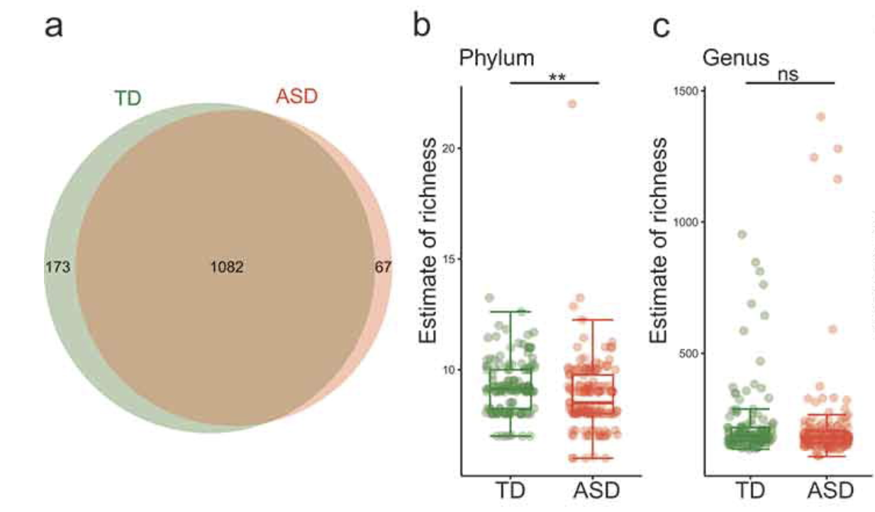
16s OTU Distribution
Figure 1A
Notes:
Taken from Figure 3 (put on slide)
Big picture: our pipeline is working (even with a different pipeline)

Slide 16
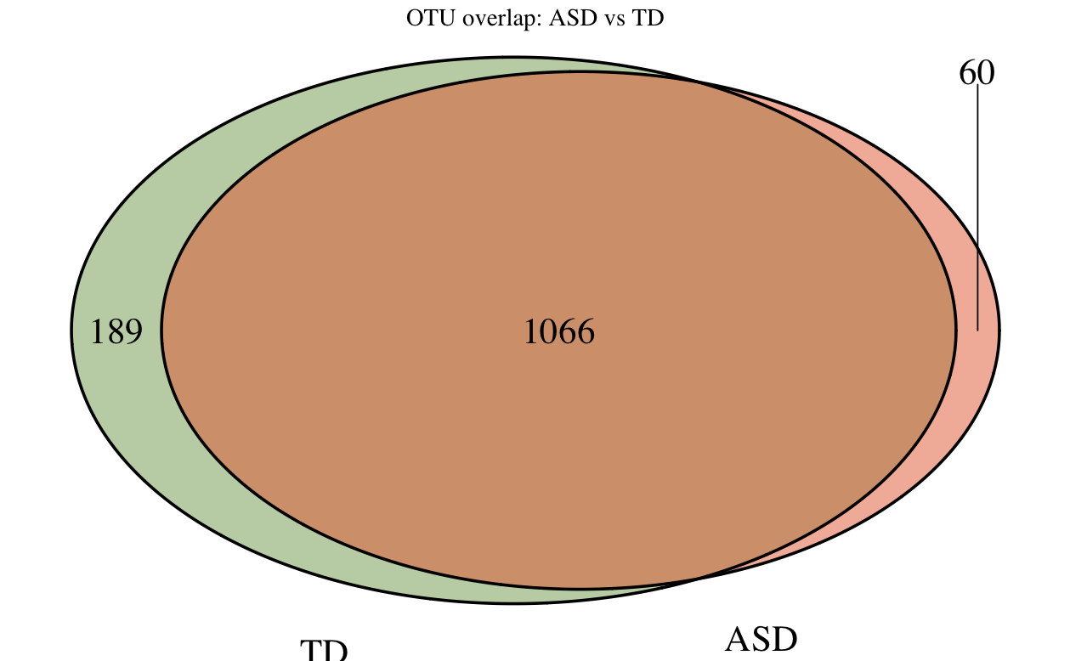
16s OTU Distribution
Figure 1A
Differences may be attributable to artifacts from rarefaction
Notes:
Taken from Figure 3 (put on slide)
Big picture: our pipeline is working (even with a different pipeline)

Slide 17
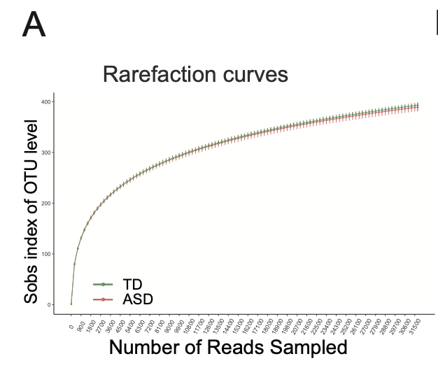
Rarefaction
Used to normalize the read-depth across samples
“Controversial” for 16S microbial community analysis
Authors likely performed some analyses before rarefying and some after
Authors only uploaded rarefied OTU table
Figure S1A

Slide 18
16s OTU Distribution
Figure 1A
Differences may be attributable to artifacts from rarefaction
Notes:
Taken from Figure 3 (put on slide)
Big picture: our pipeline is working (even with a different pipeline)

Slide 19
Diversity - Richness
Fig 1B and 1C
Notes:
1B and C
Taken from Figure 3 (put on slide)
Big picture: our pipeline is working (even with a different pipeline)

Slide 20
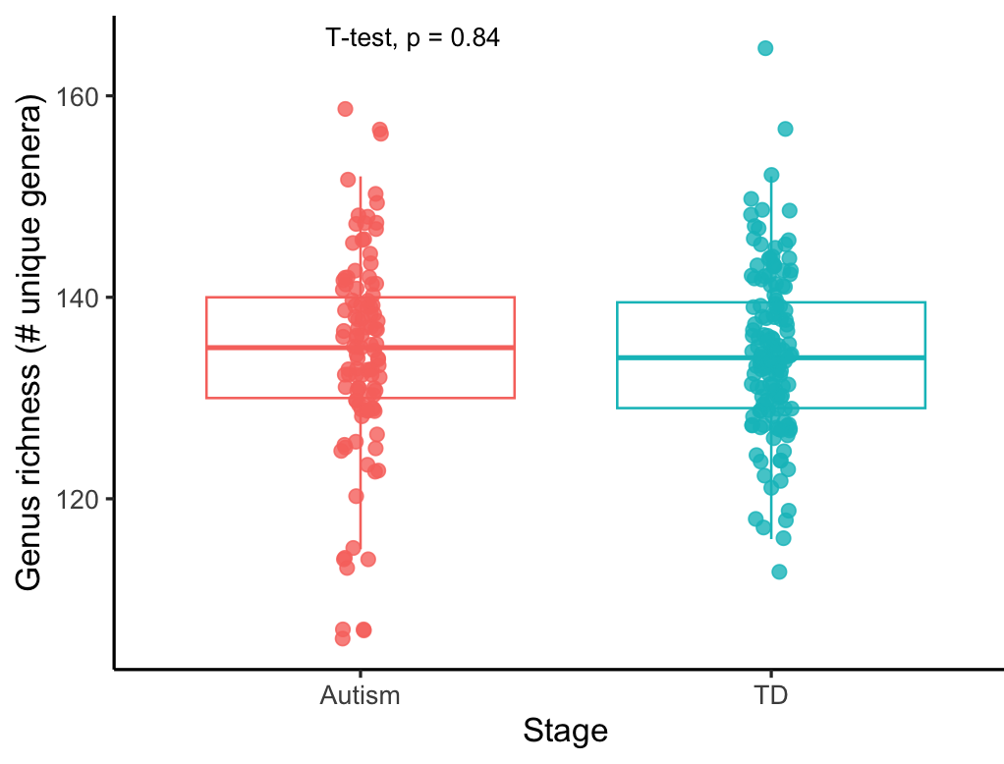
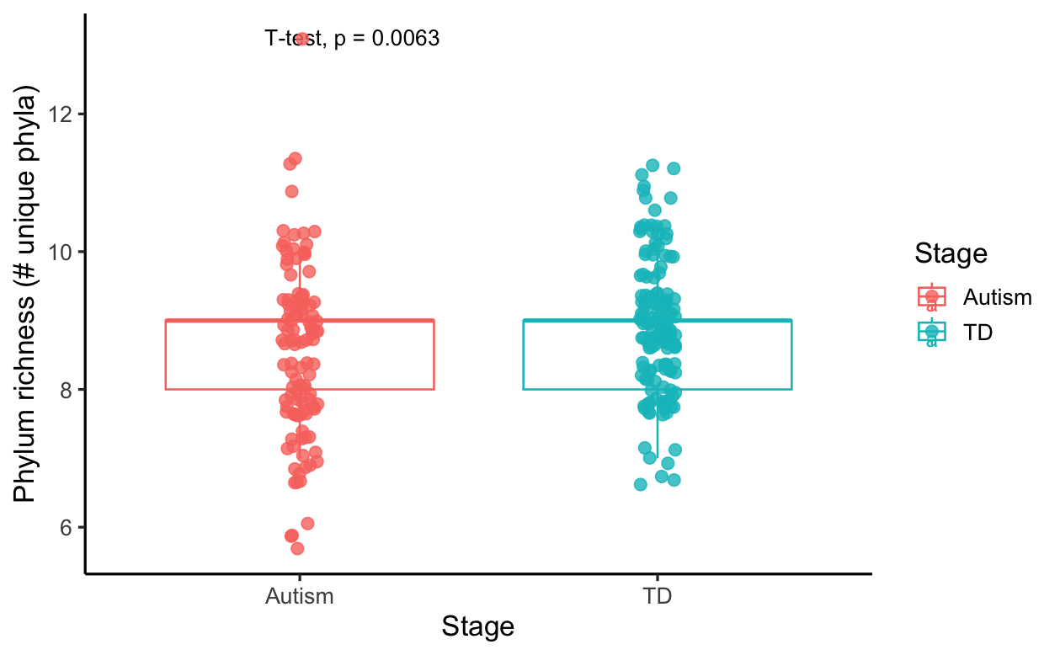
Diversity - Richness
Our best recreation - simple richness (# unique genera/phyla)
Notes:
Taken from Figure 3 (put on slide)
Big picture: our pipeline is working (even with a different pipeline)

Slide 21
Diversity - Richness
Our best recreation - simple richness (# unique genera/phyla)
They claim to have used “Breakaway” - must have un-rarefied data
Notes:
Taken from Figure 3 (put on slide)
Big picture: our pipeline is working (even with a different pipeline)

Slide 22
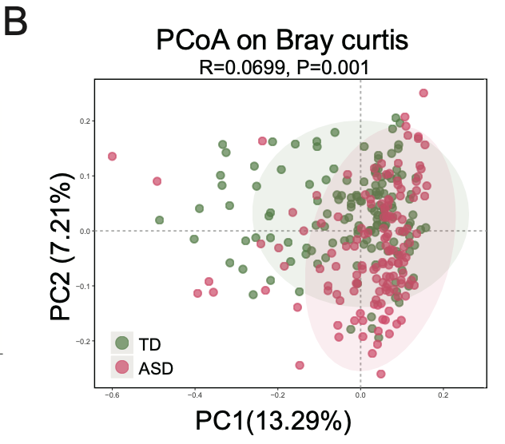
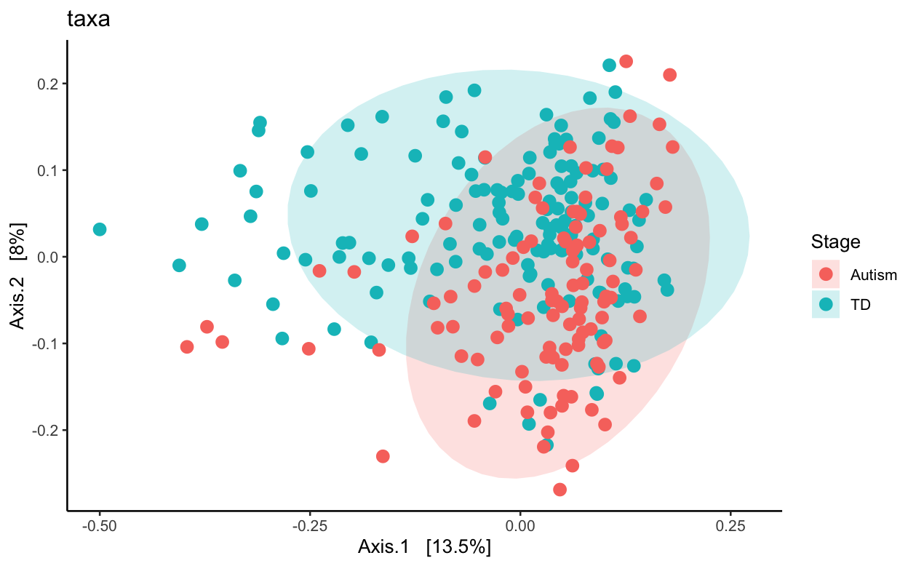
Beta Diversity - Bray Curtis
Fig S1B
Notes:
Supp 1B
Taken from Figure 3 (put on slide)
Big picture: our pipeline is working (even with a different pipeline)

Slide 23
Notes:
16S

Slide 24
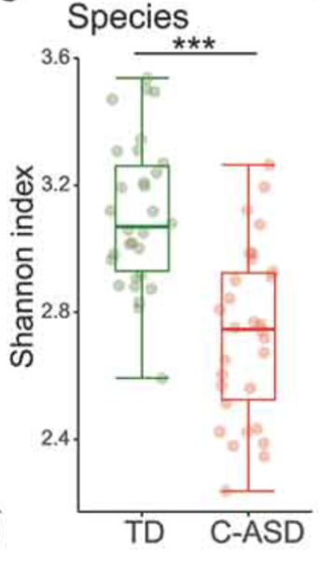
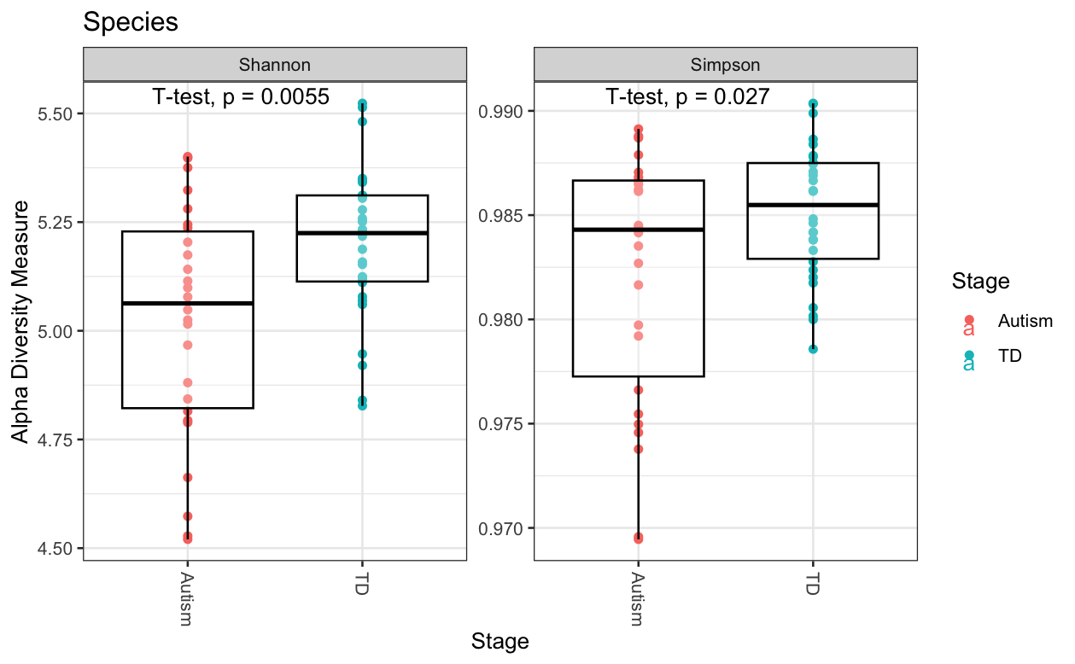
Recreated Metagenomic Fig
Notes:
Metagenomic 1:1 figures

Slide 25
Metagenomic Analysis
Notes:
How do these two different sequencing techniques compare? Looking specifically their resolution, the data we’re able to pull out, etc etc
With applications to the field of metagenomics (why we would do one versus the other, things to keep in mind as you’re choosing a research technique)

Slide 26
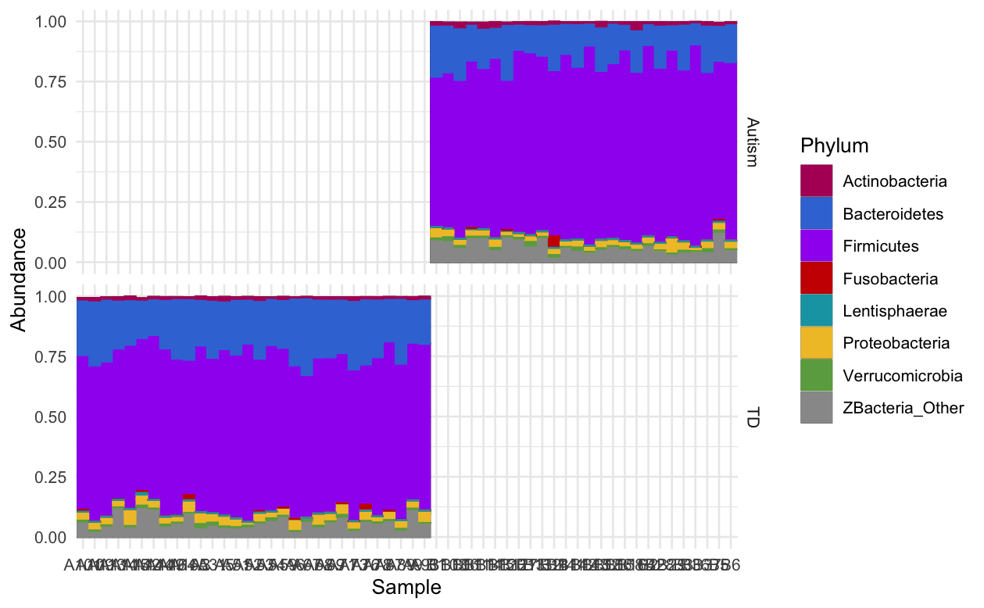
Sample size influences metagenomic analysis results
Relative abundance plot based on paper data
Notes:
Takeaway: these are 1-1 recreations
If they had better documentation, we would have recreated more figures

Slide 27
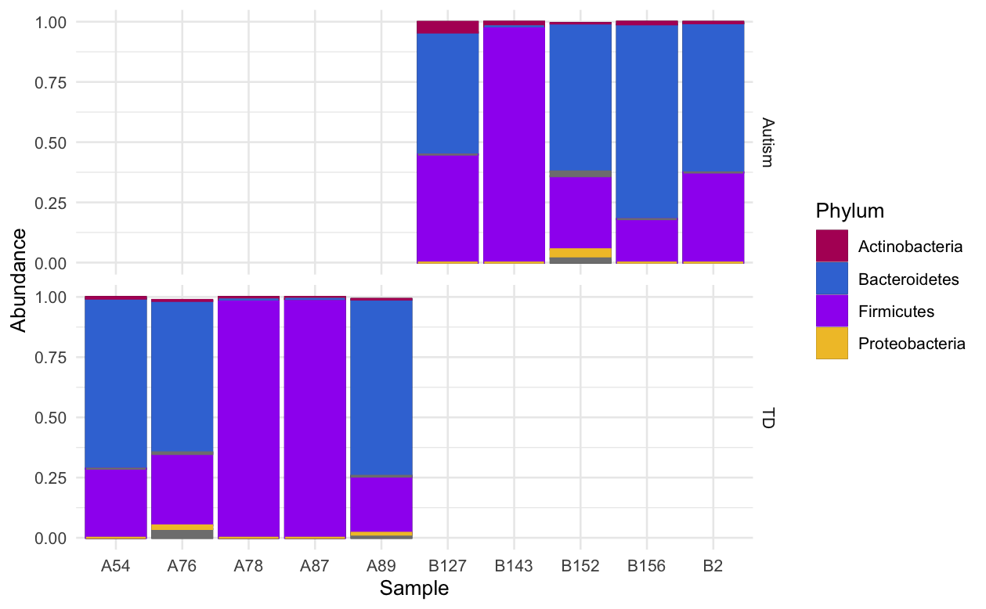
Sample size influences metagenomic analysis results
Other
Relative abundance plot based on paper data
Subset of data - our analysis
Notes:
Takeaway: these are 1-1 recreations
If they had better documentation, we would have recreated more figures

Slide 28
Direct Comparison
Notes:
How do these two different sequencing techniques compare? Looking specifically their resolution, the data we’re able to pull out, etc etc
With applications to the field of metagenomics (why we would do one versus the other, things to keep in mind as you’re choosing a research technique)

Slide 29
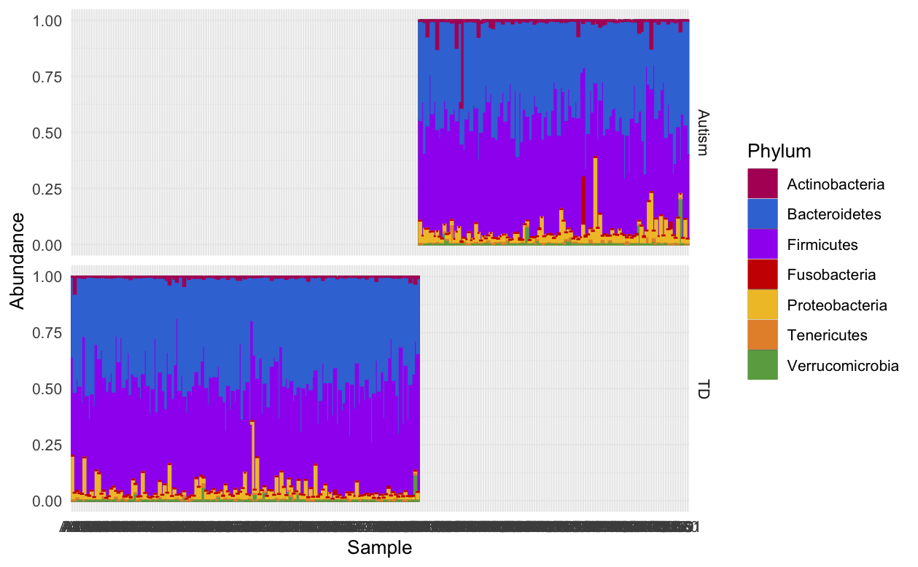
Comparing Community Composition
16s Abundance (phylum)
Notes:
In order
Stacked bar chart
alpha and beta diversity (metric of xyz)
Higher diversity from metagenomic than 16s (this is what we expected)
PCOA - measure of beta diversity
Different in microbial communities between each sample
Better separated in metagenomic compared to 16s (if not, this is a reason why people still use 16s)
If time: sample size discussion

Slide 30
Comparing Community Composition
Other
16s Abundance (phylum)
Metagenomic Abundance (phylum)
Notes:
In order
Stacked bar chart
alpha and beta diversity (metric of xyz)
Higher diversity from metagenomic than 16s (this is what we expected)
PCOA - measure of beta diversity
Different in microbial communities between each sample
Better separated in metagenomic compared to 16s (if not, this is a reason why people still use 16s)
If time: sample size discussion

Slide 31
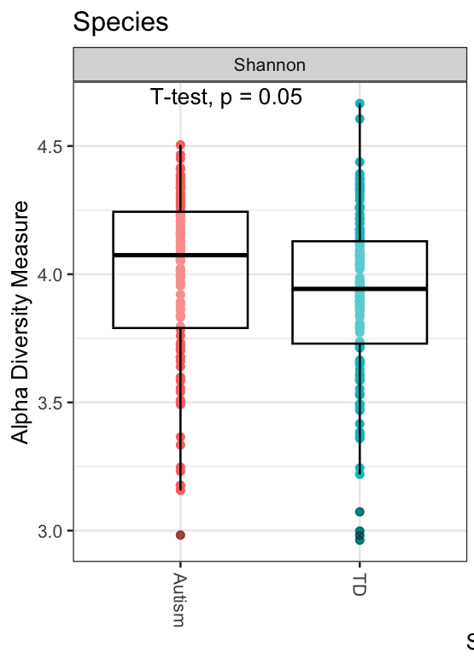
Comparing Alpha Diversity
16S
Notes:
Crop simpson index out
In order
Stacked bar chart
alpha and beta diversity (metric of xyz)
Higher diversity from metagenomic than 16s (this is what we expected)
PCOA - measure of beta diversity
Different in microbial communities between each sample
Better separated in metagenomic compared to 16s (if not, this is a reason why people still use 16s)
If time: sample size discussion

Slide 32
Comparing Alpha Diversity
16S
Metagenomic
Notes:
Crop simpson index out
In order
Stacked bar chart
alpha and beta diversity (metric of xyz)
Higher diversity from metagenomic than 16s (this is what we expected)
PCOA - measure of beta diversity
Different in microbial communities between each sample
Better separated in metagenomic compared to 16s (if not, this is a reason why people still use 16s)
If time: sample size discussion

Slide 33
Comparing Alpha Diversity
16S
Metagenomic
Metagenomic approach captures more diversity
Metagenomic captures some fungal and viral components - so this makes sense
Notes:
Crop simpson index out
In order
Stacked bar chart
alpha and beta diversity (metric of xyz)
Higher diversity from metagenomic than 16s (this is what we expected)
PCOA - measure of beta diversity
Different in microbial communities between each sample
Better separated in metagenomic compared to 16s (if not, this is a reason why people still use 16s)
If time: sample size discussion

Slide 34
Comparing Beta Diversity
PCoA of Bray-Curtis Dissimilarity - 16S
Notes:
In order
Stacked bar chart
alpha and beta diversity (metric of xyz)
Higher diversity from metagenomic than 16s (this is what we expected)
PCOA - measure of beta diversity
Different in microbial communities between each sample
Better separated in metagenomic compared to 16s (if not, this is a reason why people still use 16s)
If time: sample size discussion

Slide 35
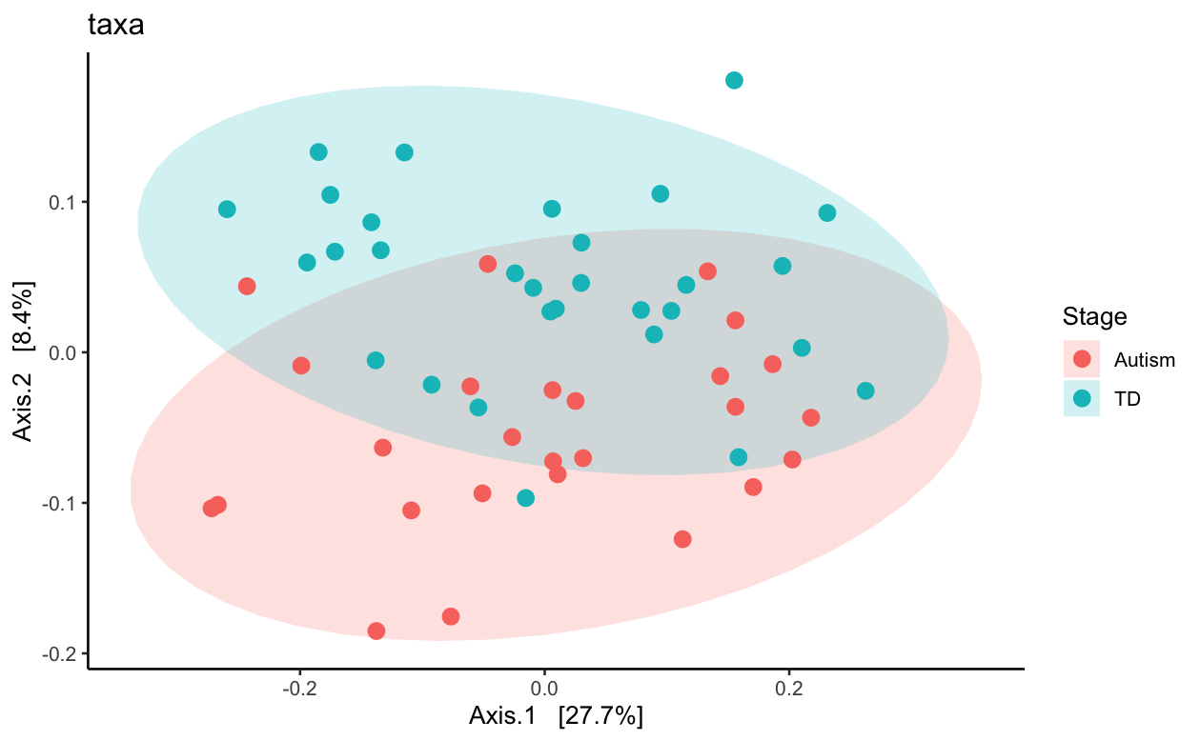
Comparing Beta Diversity
PCoA of Bray-Curtis Dissimilarity - 16S
PCoA of Bray-Curtis Dissimilarity - Metagenomic
Notes:
In order
Stacked bar chart
alpha and beta diversity (metric of xyz)
Higher diversity from metagenomic than 16s (this is what we expected)
PCOA - measure of beta diversity
Different in microbial communities between each sample
Better separated in metagenomic compared to 16s (if not, this is a reason why people still use 16s)
If time: sample size discussion

Slide 36
Comparing Beta Diversity
PCoA of Bray-Curtis Dissimilarity - 16S
PCoA of Bray-Curtis Dissimilarity - Metagenomic
Without statistics it is hard to say - could be a sample size effect as well
Notes:
In order
Stacked bar chart
alpha and beta diversity (metric of xyz)
Higher diversity from metagenomic than 16s (this is what we expected)
PCOA - measure of beta diversity
Different in microbial communities between each sample
Better separated in metagenomic compared to 16s (if not, this is a reason why people still use 16s)
If time: sample size discussion

Slide 37
Metagenomic sequencing: a more robust capture of diversity present
Notes:
Bring back to alpha and beta diversity
This is a pro but only depending on your experiment

Slide 38
Next Steps
Exact pipeline
Working with the full dataset
Replicate analysis with another dataset for more robust comparison

Slide 39
Challenges
Documentation issues!
Incomplete datasets uploaded!!
Bad for rigor and reproducibility!!!
Notes:
Fundamental issue in the field – metagenomics analysis methods sections are TOO SPARSE (github published to compensate)

Slide 40
Thank You!
Questions?
Notes:
Fundamental issue in the field – metagenomics analysis methods sections are TOO SPARSE (github published to compensate)

Slide 41
Attribute image sources here

